Slide 1
Saan Ka
Developing a user-centered data-collection experience for Metro Manilla commuters and researchers
Junwoo Cheong | Julie Choi | Ariana Daly | Isadora Krsek | Robert Managad
Notes:
Robert

Slide 2
Iteration process Outline
Internal testing Meeting w/ Noah
UX testing on transit AB Testing
We’re on this stage!
Wireframe Iteration 1 (lo-fi)
Wireframe Iteration 2 (mid-fi)
Wireframe Iteration 3 (hi-fi)
Onboarding too long Confusing logging experience
Shortened onboarding Revamped logging experience
Integration of visual design Logging experience v3
Notes:
Robert

Slide 3
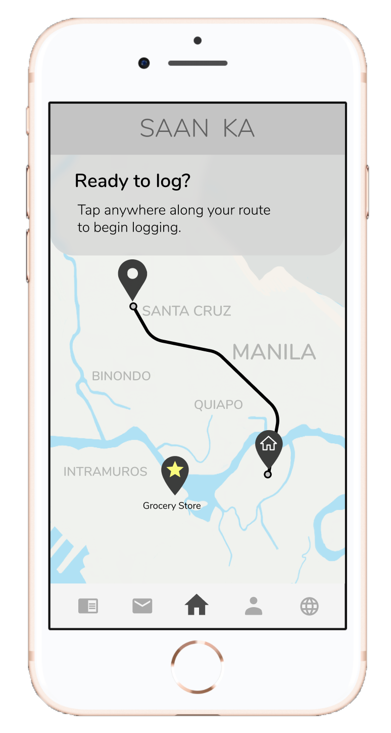
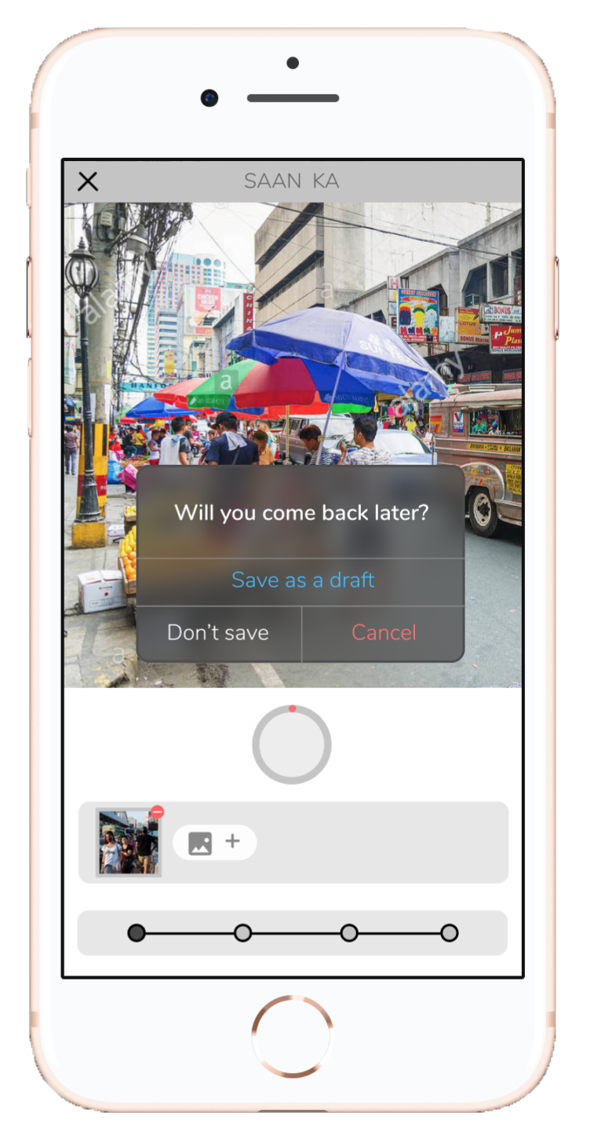
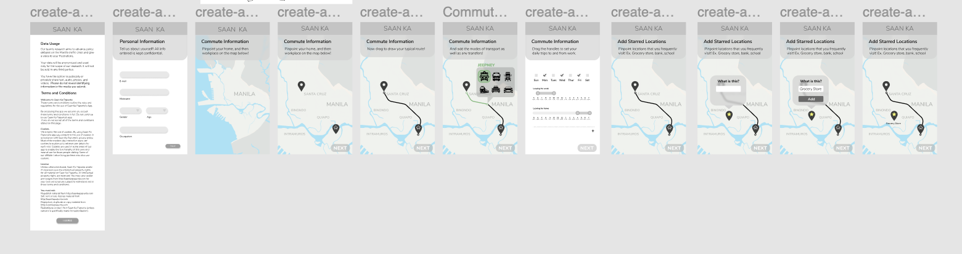
Wireframe iteration 1 Lo-fi development
11 screens
Very long onboarding process
Focused on route/commute scheduling, so we had people inputting a lot of extra info.
Route-based logging
Users had to be somewhere on their route from home to work to start a documentation.
Notes:
Junwoo
Our internal user testing found that there was just way too much in the onboarding section (eleven screens worth).
We also started our approach with users having to log on a pre-determined path.
These didn’t really go well in terms of user flow and use cases, respectively.

Slide 4
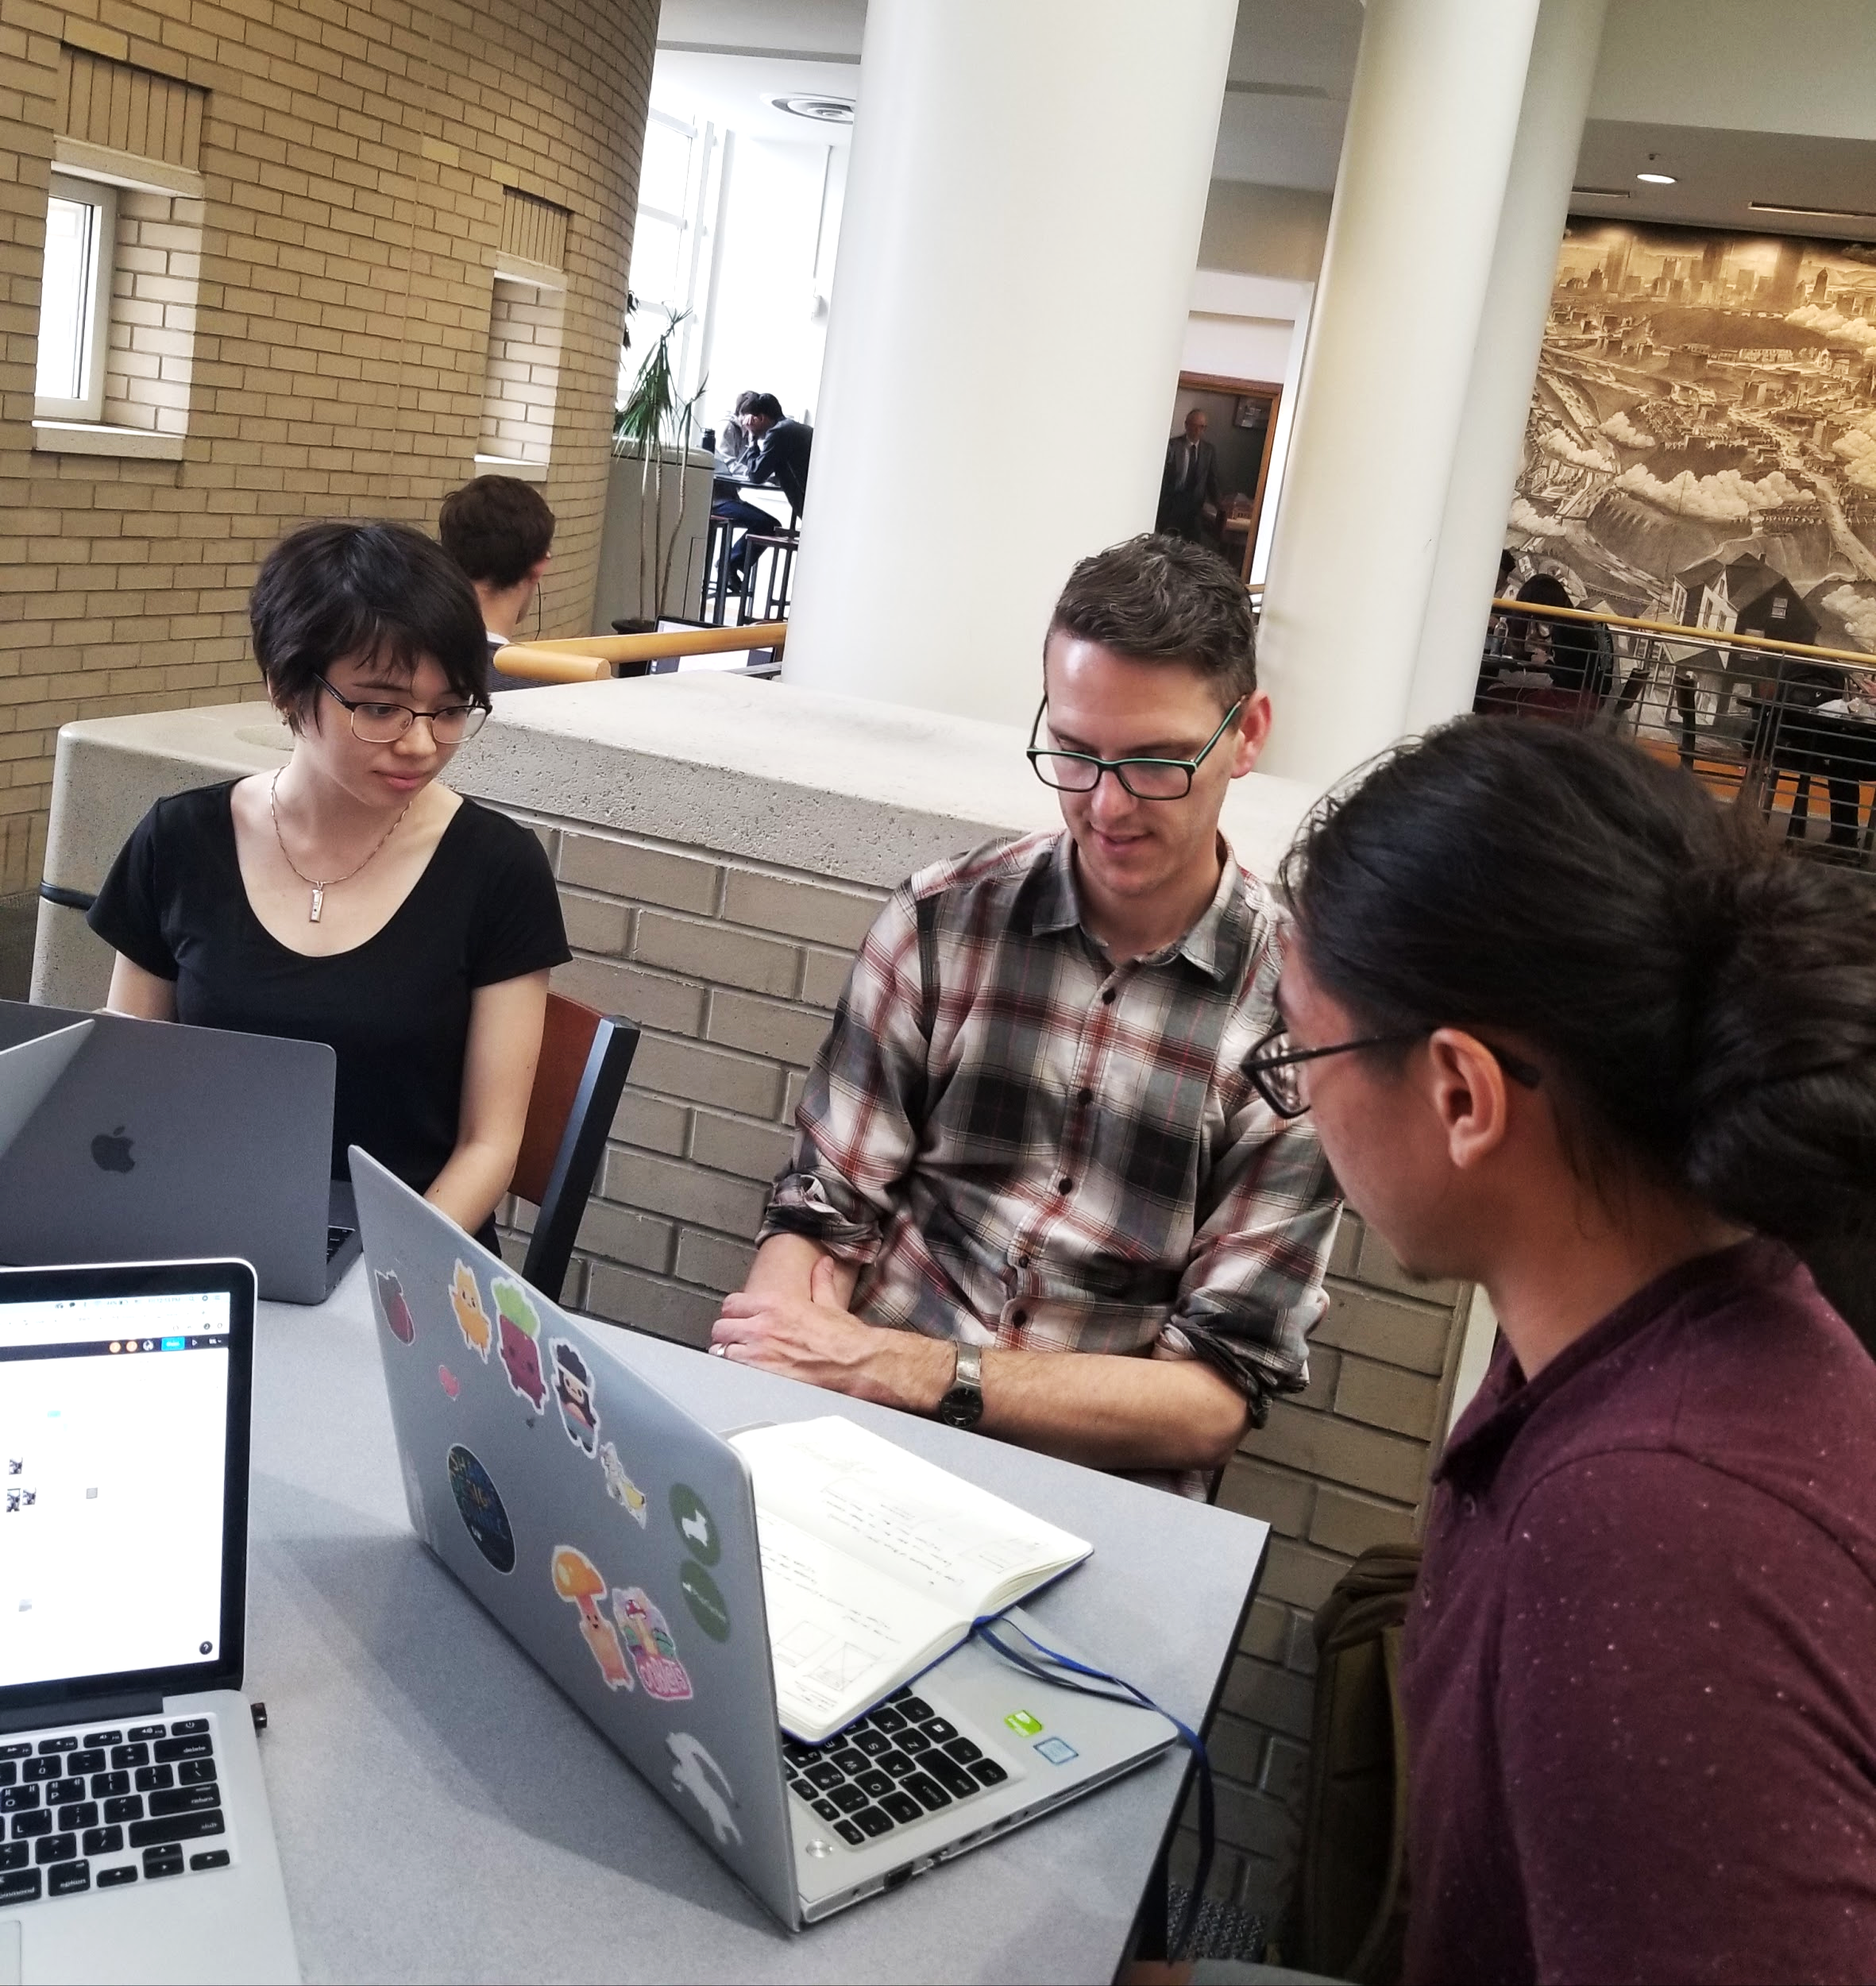
Checking in with Noah Theriault Plus internal user testing
Post mid review
Feedback session on iteration 1
Some additional features
Researcher end UX/UI development-- desktop view
Discussed user flow for logging
Users should reach the camera view sooner
Location of photos is essential, but users should be able to skip other parts of the survey
Not all users will have data while on the road
Notes:
Ari

Slide 5
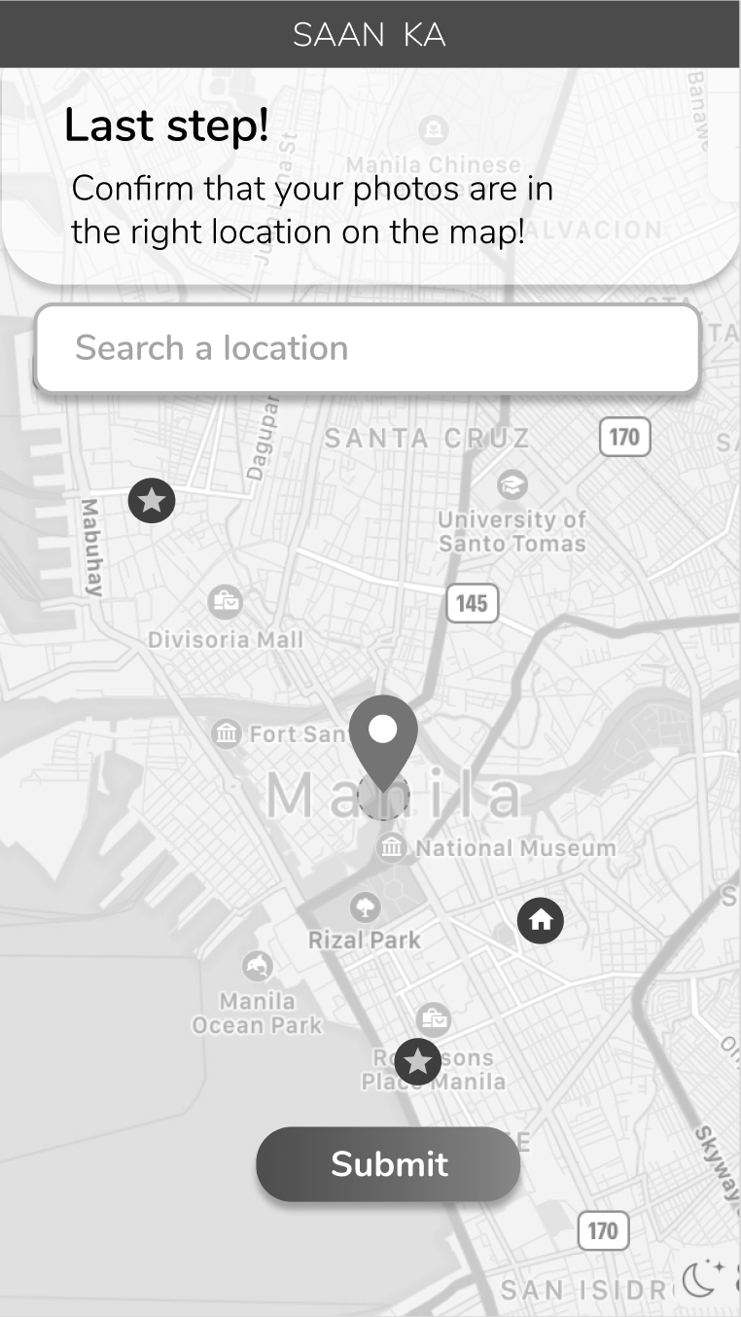
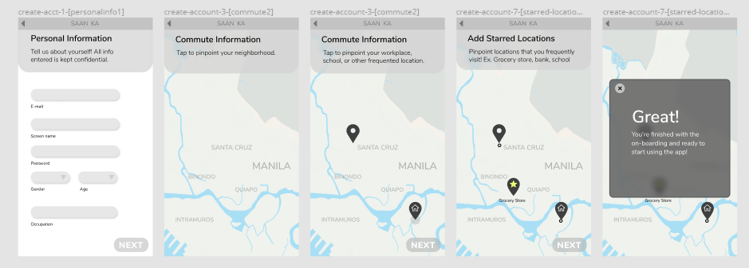
Wireframe iteration 2 Mid-fi development
5 screens
Shortened onboarding
Reduced experience down to just five screens, focusing on key locations.
Revamped logging experience
Experience now focused on logging immediately, rather than first selecting a location.
Notes:
Julie
Some of the immediate changes we made after meeting with Noah was reducing amount of onboarding screens. (figured out what was necessary/not necessary)
On Noah’s suggestion, we flipped our user experience and started working on screens where users could log information first, then log their location.

Slide 6
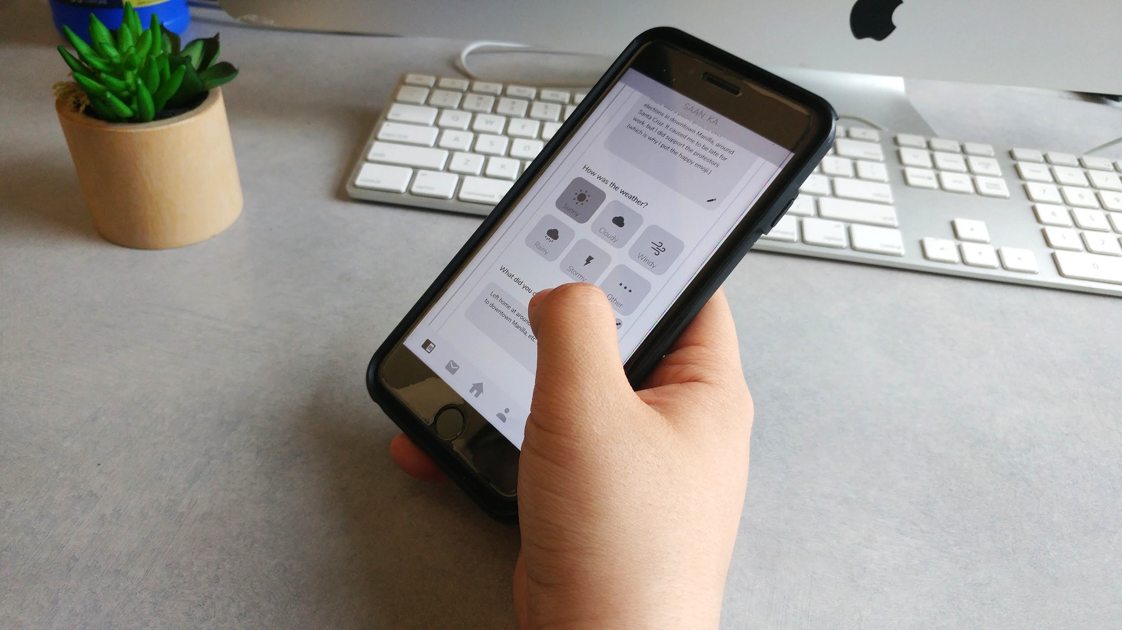
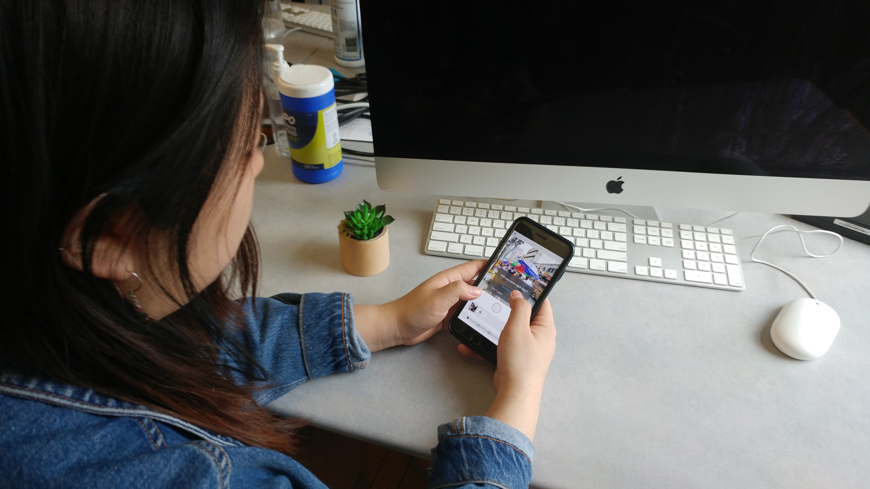
User testing Observing inputs, confusion, and successes
Tested by several college students
Asked to perform specific tasks.
Areas to improve:
Fluidity in screens transitions
Better use of GeoTag
Unified home screen with Emotion map
Notes:
Ari

Slide 7
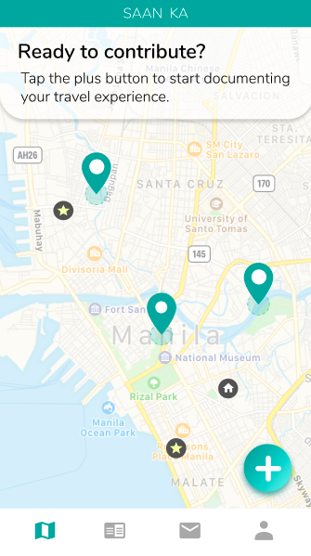
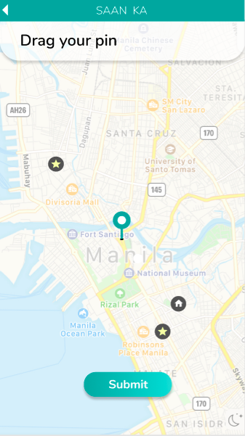
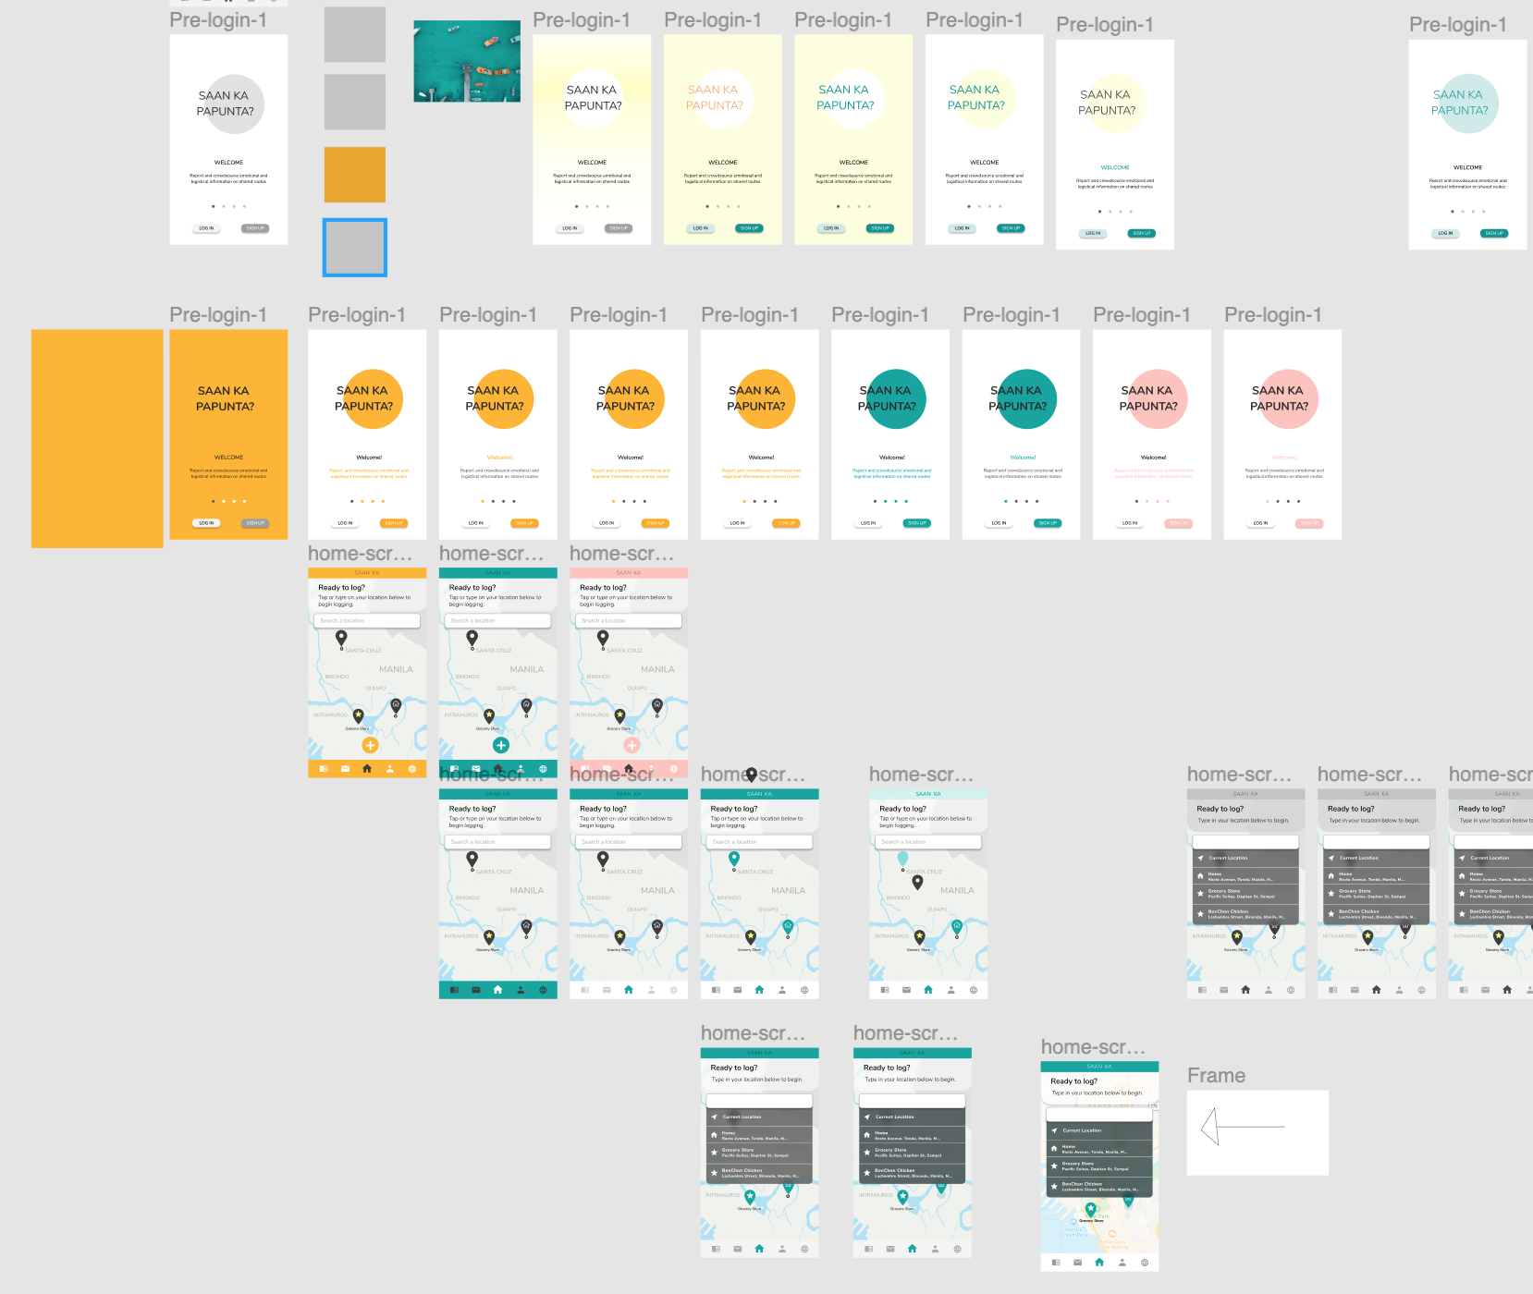
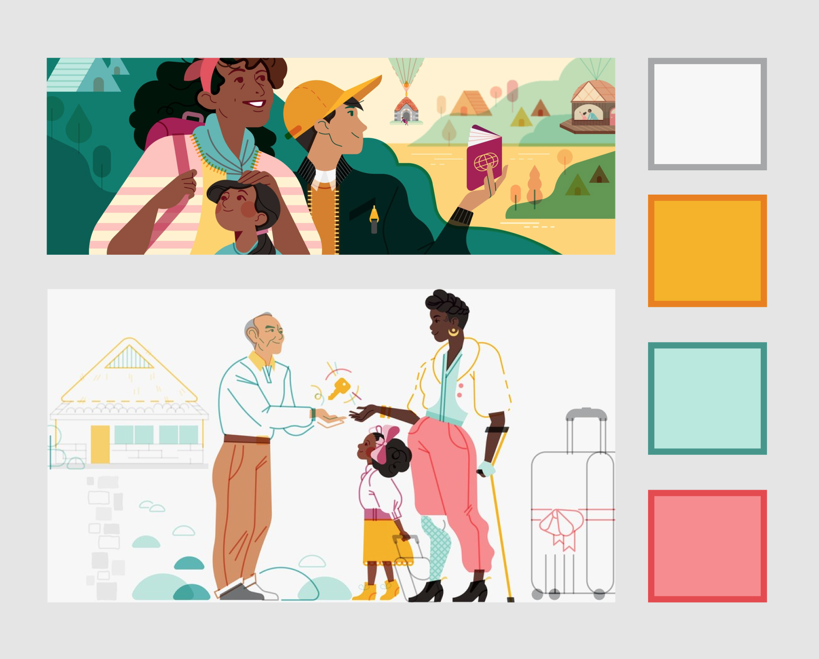
Wireframe iteration 3 Hi-fi development
Integration of visual design
Currently integrating color, typography, and iconography into user experience.
Logging Experience V3
Fleshing out the “log-first, select a location after” approach using pins and markers.
Notes:
Robert

Slide 8
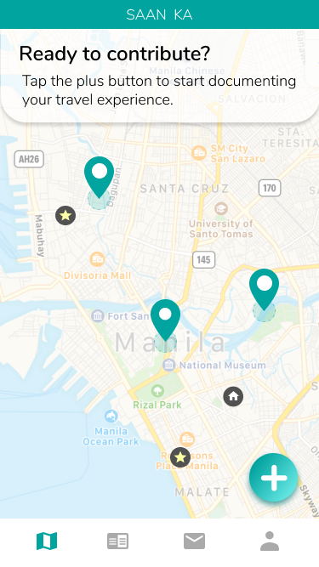
Final Prototype Mini Demo
https://www.figma.com/proto/cEeevgfnm8tXuwsmvXRUXIH1/Saan-Ka-Papunta?node-id=676%3A4506&scaling=scale-down
Notes:
Isadora

